Slide 1

Improvement of a Ticketing System
Team Member:
Yujun Liu
Wenliang Peng
Chao Zhang
Yuanhao Zhong
Mentor:
Simon Fuchs
Omar Shouman
Master-Praktikum - Machine Learning für Wirtschaftsinformatiker
13. July 2021

Slide 2
Outline
Background ＆ Problem
Task Allocation ＆ Time Schedule
Modelling Task
Data Extraction
Multi-language Processing
Preprocessing
ML Model
Post-analysis
Evaluation
Possible Future Work

Slide 3
Background ＆ Problem
The user-data currently collected by UCC's ticket support system lacks accurate classification labels. For supervised learning, the accuracy of the labels directly determines the quality of the model. How can we introduce ML algorithm into ticket support system?
Ideas:
Extract the effective text information
Use NLP algorithms to process text data
Extract the keywords
Unsupervised learning: clustering algorithm
Notes:
How to make a preliminary classification after a user sends a message for the first time?
How to automatically reply emails/make FAQs based on customer questions?

Slide 4
Task Allocation ＆ Time Schedule
Task | Name
Literature research and problem analysis | all
Demand analysis and data analysis | Peng, Zhong
Data extraction and multi-language data processing | Peng, Zhang
Preprocessing | Peng, Zhong
Model building | Liu, Zhang
Post-analysis | Liu, Zhang
Model evaluation | Liu, Zhong
Correction and documentation | all

Slide 5
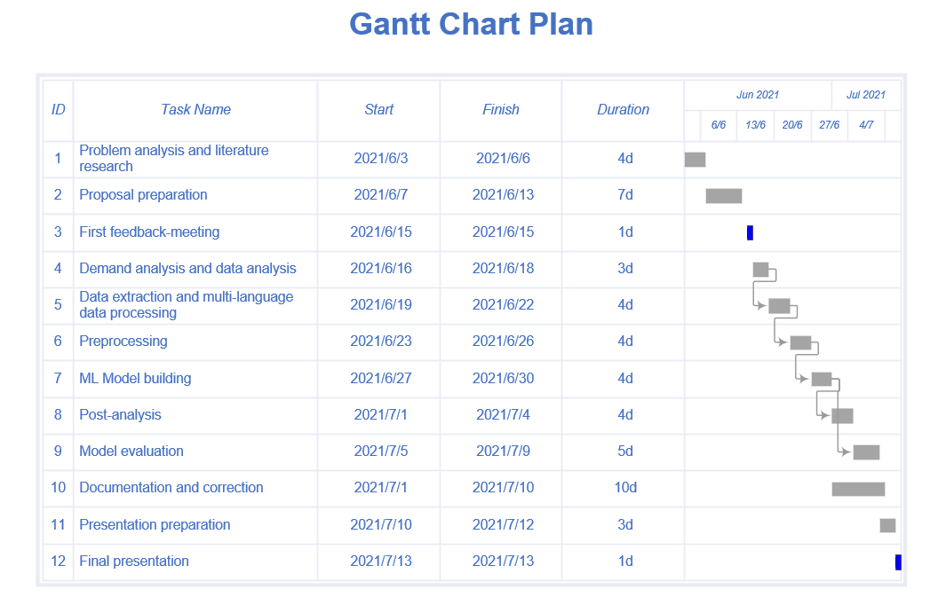
Task Allocation ＆ Time Schedule

Slide 6
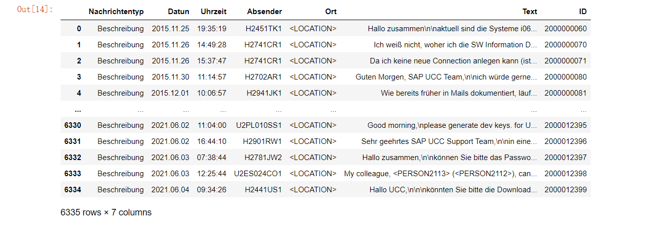
Data Extraction
Remove invalid tickets
Alert tickets
Blank tickets
Tickets without "Beschreibung" and "E-mail von Kunde"
Extract data from valid tickets
Extract the first "Beschreibung" and "E-mail von Kunde" from every valid tickets

Slide 7
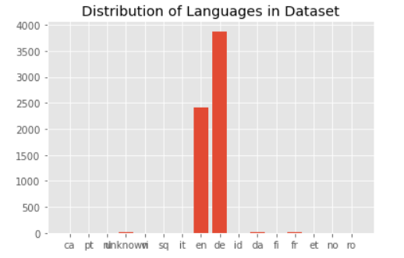
Multi-language Processing
Language detection
Main languages: English (2406 samples) and German (3877 samples)
other languages: misclassified
only samples that are recognized as German and English

Slide 8
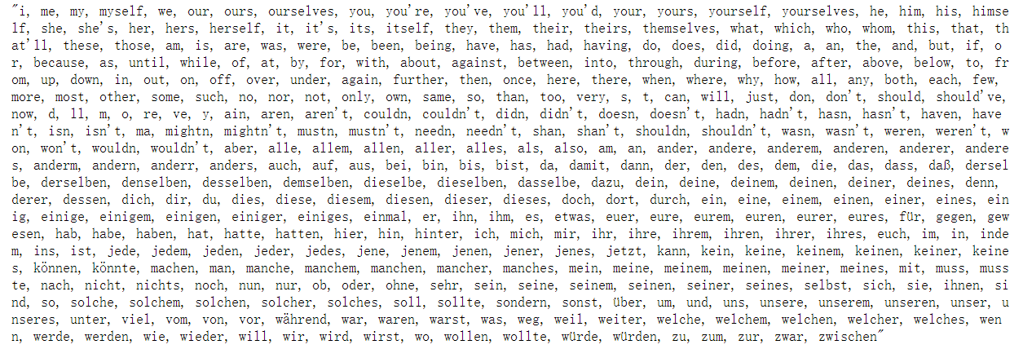
Preprocessing
Removal of sensitive words
Like <LOCATION1>, <PERSON20>
Removal of spaces and line feeds
Lower casing
Removal of punctuations
!"#$%&'()*+,-./:;<=>?@[\]^_`{|}~ punctuations replaced by spaces
Removal of stop-words
most common words, but not significant

Slide 9
Preprocessing
Removal of frequent words
filtered out the 130 highest frequency words
manually kept the meaningful words
Removal of Rare words
appeared once/twice
Removal of numbers and words starting with a number
Like 5th for date or number from partial ip address after Removal of punctuations (192 0 0 1)
Lemmatization
Different approaches to German and English texts
Vectorization
TF-IDF (term frequency-inverse document frequency)

Slide 10
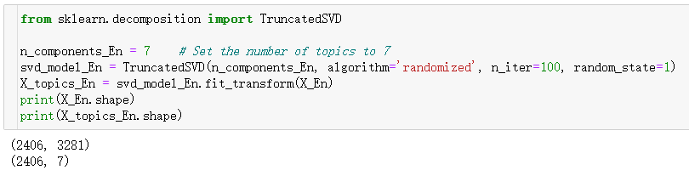
Machine Learning Model – Truncated SVD
Latent Semantic Analysis (LSA)
Get the key topic
Truncated Singular Decomposition → retain the largest singular value
Process of LSA
Original feature vector X: N x D (number of ticket’s samples, number of words)
New feature vector X_topics: N x T (number of ticket’s samples, number of topics)
Notes:
After preprocessing, we got a vector X, which stores the text information of all tickets. We now want to apply a clustering algorithm to this vector X to study the topic focusing on the text information of all ticket’s samples.
We first tried the method of latent semantic analysis (LSA). Through topic analysis by LSA, we can get the key topic in the corpus, which means the importance of each word in the topic, and the tendency of each ticket sample on each topic. And based on them, keywords and representative texts corresponding to the theme can be obtained.
LSA is actually just a truncated singular value decomposition of a (very high-rank and sparse) document-term matrix, only retaining the largest singular value of n_components.
Using Truncated SVD, transform the original feature vector X with a scale of N*D (number of ticket’s samples, number of words) into a new feature vector X_topics with a scale of N*T (number of ticket’s samples, number of topics):

Slide 11
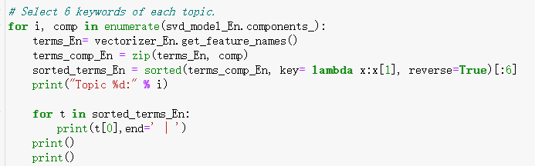
Machine Learning Model – Truncated SVD
Goal: get the topics using LSA
svd_model_En.components_: (i, j) = (number of topics, number of words)
Notes:
Svd_model.components_ is a vector with a scale of N*D (number of topics, number of words), and the elements in (i, j) represent the weight of word j on topic i. The higher the weight of word j, it can be considered more representative on the topic I, and we use this to select the most representative the keywords of the topics.

Slide 12
Machine Learning Model – Truncated SVD
Goal: get the topics using LSA
NO. of topic | Keywords (English) | Keywords (German)
1 | client | reset | gbi | user | hana | password | mandanten | user | zurücksetzen | gbi | mandant | team
2 | client | date | contract | team | gbi | provision | zurücksetzen | mandanten | mandant | i20 | hiermit | bitten
3 | reset | master | password | client | account | many | niklas | grüsse | gut | können | genannt | bestätigung
4 | key | generate | user | i78 | mandant | developer | user | niklas | grüsse | passwort | gut | können
5 | password | master | account | hana | user | date | mandantenrücksetzung | schulung | sperren | mandant | i45 | i16
6 | gbi | version | upgrade | case | study | master | mandantenrücksetzung | schulung | gbi | user | sperren | i16
7 | saprouter | connection | server | client | router | message | gbi | hana | vg | zurücksetzen | i81 | können
Table: Keywords of the topics
Notes:
Although we got the topics using LSA, we did not find a suitable method to match the topics with the ticket’s samples, so we tried to use K-means for clustering.

Slide 13
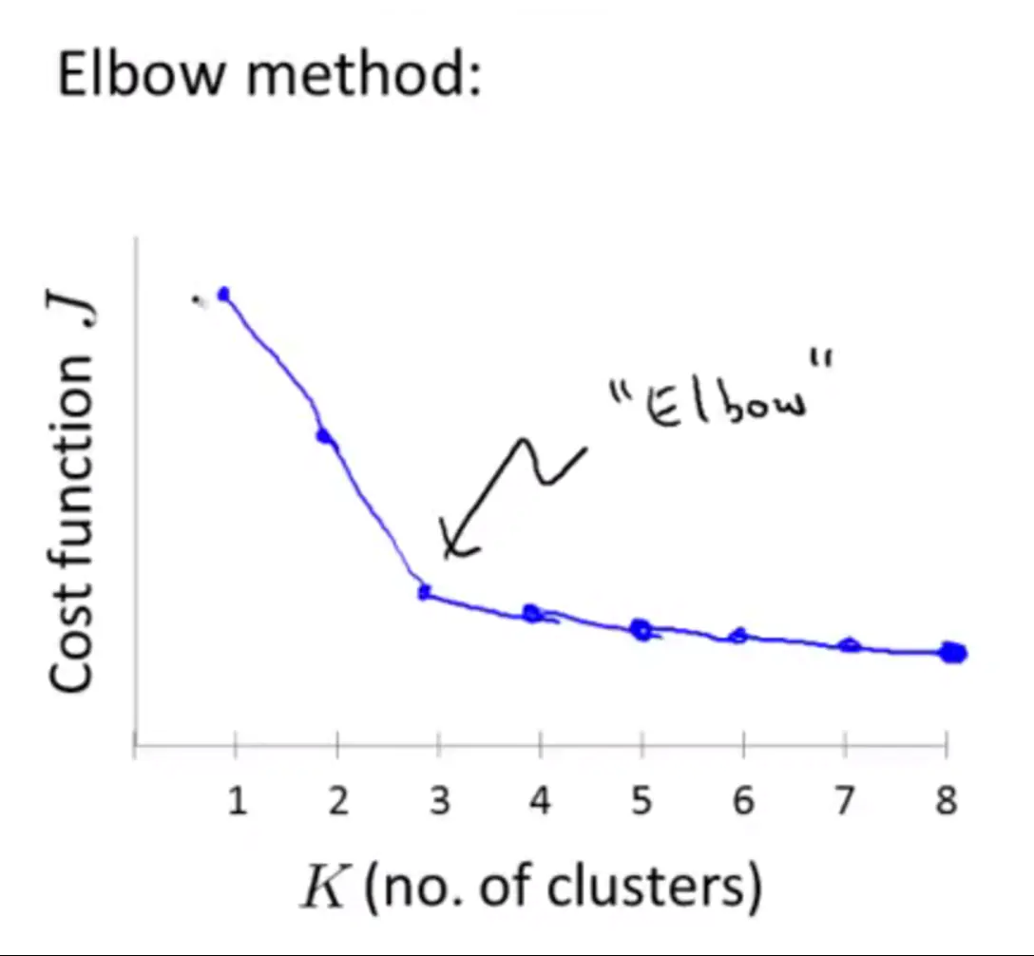
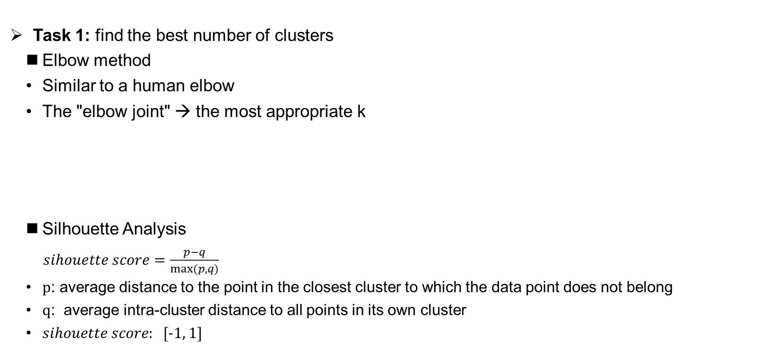
Machine Learning Model – K-means Clustering
Task 1: find the best number of clusters
Elbow method
Similar to a human elbow
The "elbow joint" → the most appropriate k
Silhouette Analysis
$sihouette score=\frac{p−q}{max⁡(p, q)}$
p: average distance to the point in the closest cluster to which the data point does not belong
q: average intra-cluster distance to all points in its own cluster
$sihouette score$: [-1, 1]
Source：https://www.programmersought.com/article/11473205350/
Notes:
The elbow curve is similar to a human elbow, and the value of k corresponding to the "elbow joint" part is the most appropriate k, but sometimes the "elbow joint" of the elbow curve is not obvious, so we can use the silhouette score to analyze, The the silhouette score is a criterion for judging whether the clustering is good or bad.
Silhouette score can be calculated with (p-q) / max(p,q), where p is the average distance to the point in the closest cluster to which the data point does not belong, q is the average intra-cluster distance to all points in its own cluster.
The value of the silhouette score range is between -1 to 1.
A score close to 1 indicates that the data point is very similar to other data points in the cluster.
A score close to -1 indicates that the data point is not similar to the data points in its cluster.

Slide 14
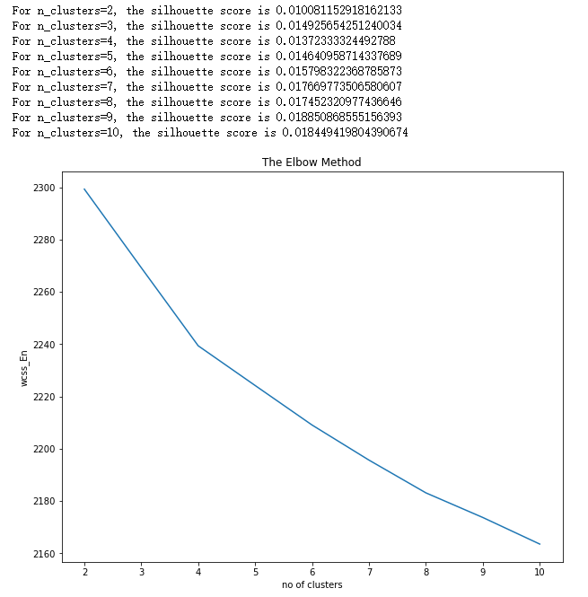
Machine Learning Model – K-means Clustering
Result of using the elbow method and silhouette analysis
Figure: Results of elbow method and silhouette analysis (English)
Notes:
We choose the number of clusters to be 4, 6, and 7 to visualize the data.

Slide 15
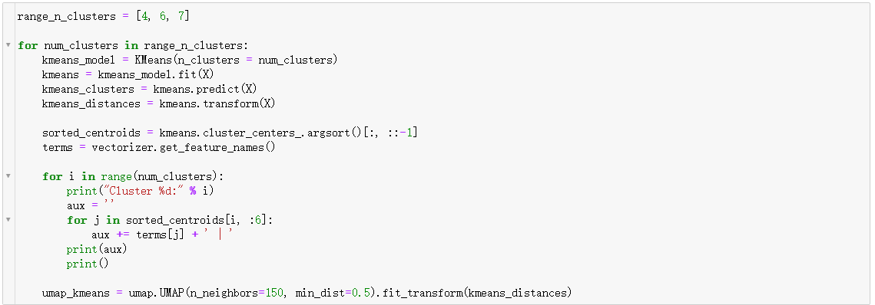
Machine Learning Model – K-means Clustering
Task 2: visualization on the 2D plane
Uniform Manifold Approximation and Projection (UMAP)
t-SNE
Notes:
As we mentioned before, the feature vector X we got after TfidfVectorizer processing is high-dimensional, and we need to visualize the cluster distance space obtained after K-means clustering on the 2D plane.
UMAP is a brand-new dimensionality reduction technology, especially suitable for the visualization of high-dimensional data sets. Its goal is to find a representation of high-dimensional points in a low-dimensional space (usually a 2D plane). In terms of visual quality, compared with t-SNE, UMAP retains a more global structure and has superior operating performance.
Similar to the svd_model.components_ we referred to before, kmeans.cluster_centers_ is also a vector with a scale of N*D (number of clusters, number of words), and the elements in (i, j) represent the weight of word j on cluster i. The higher the weight of word j, the more representative it is on cluster i, and we use this to select the most representative keywords of clusters.

Slide 16
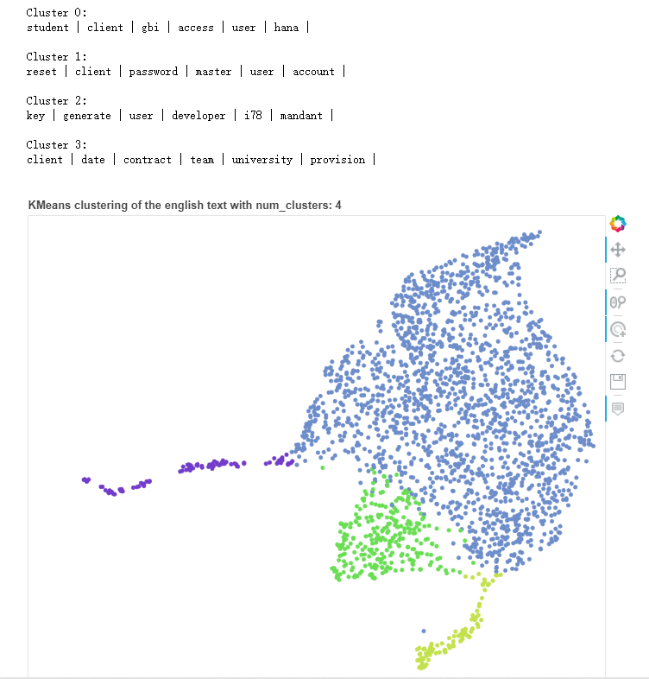
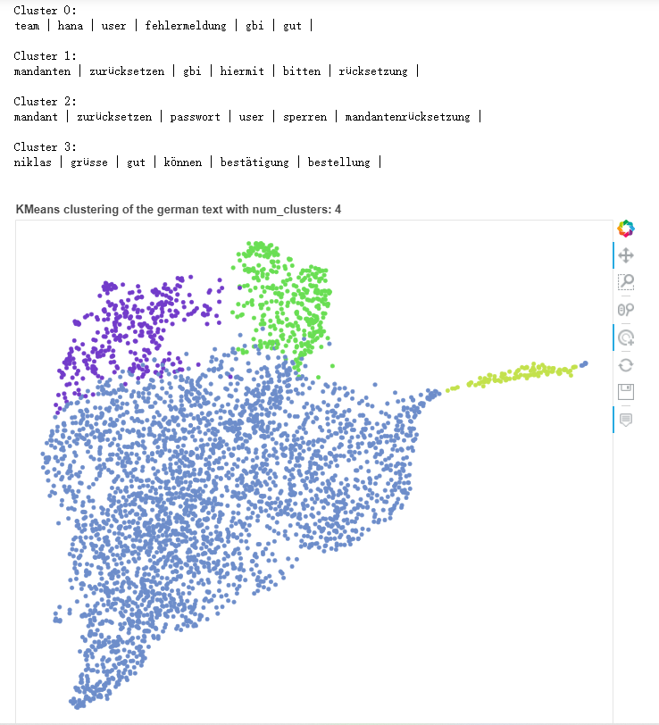
Machine Learning Model – K-means Clustering
Task 2: visualization on the 2D plane

Slide 17
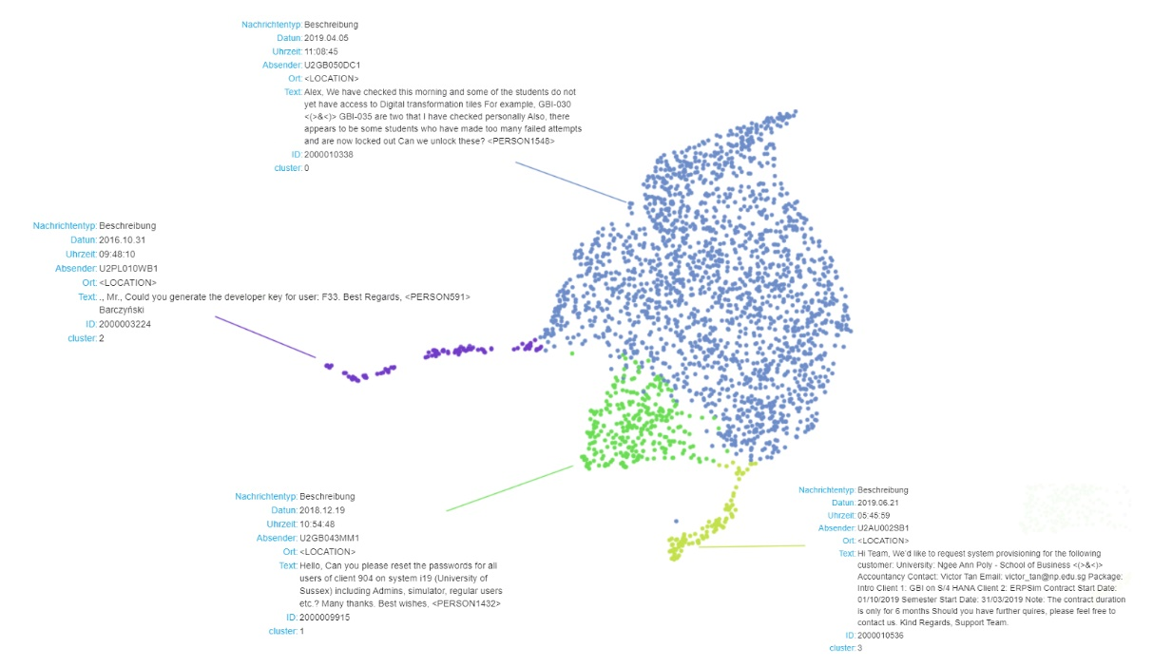
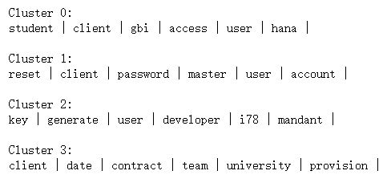
Machine Learning Model – K-means Clustering
Task 2: visualization on the 2D plane (English)
Notes:
When we click on one of the tickets' samples with the mouse, we can get some information about this ticket's sample, such as information type, time, ID, etc. The most important is the text information, as shown in the figure, we have selected a sample from each cluster as a display. By looking at the keywords in the cluster corresponding to the sample we can see that the textual information of the sample corresponds roughly to the keywords of the cluster to which the sample belongs.
In addition, we found that English Cluster3 contains a lot of sensitive information. Almost all of the names of people, schools, and contact details are not treated for sensitive words. Therefore, the sensitive word processing in the ticket support system can be paid more attention to the data in this cluster.

Slide 18
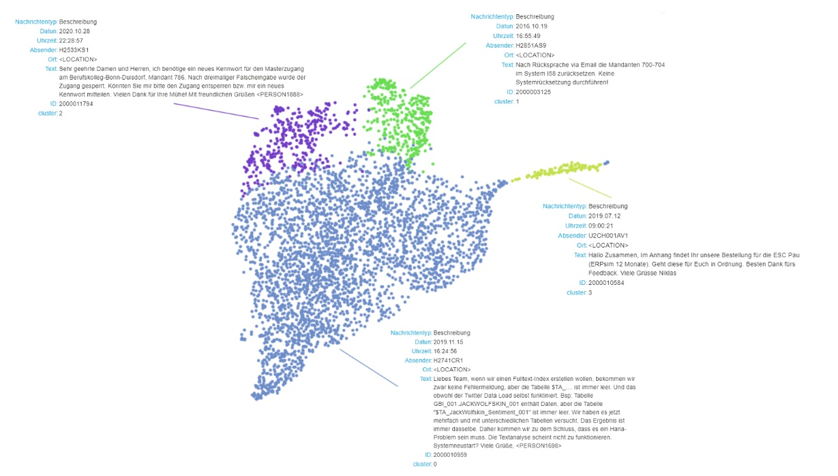
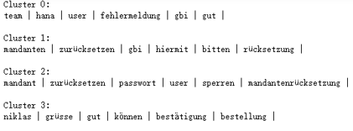
Machine Learning Model – K-means Clustering
Task 2: visualization on the 2D plane (German)

Slide 19
Machine Learning Model – Truncated SVD
Meaning of Topics after Truncated SVD
NO. of topic | Keywords (English) | Keywords (German)
1 | client | reset | gbi | user | hana | password | mandanten | user | zurücksetzen | gbi | mandant | team
2 | client | date | contract | team | gbi | provision | zurücksetzen | mandanten | mandant | i20 | hiermit | bitten
3 | reset | master | password | client | account | many | niklas | grüsse | gut | können | genannt | bestätigung
4 | key | generate | user | i78 | mandant | developer | user | niklas | grüsse | passwort | gut | können
5 | password | master | account | hana | user | date | mandantenrücksetzung | schulung | sperren | mandant | i45 | i16
6 | gbi | version | upgrade | case | study | master | mandantenrücksetzung | schulung | gbi | user | sperren | i16
7 | saprouter | connection | server | client | router | message | gbi | hana | vg | zurücksetzen | i81 | können
Table: Keywords of the topics
Notes:
Through the truncated SVD process, we downscaled the high-dimensional text data to the most important 7 dimensions/feature space and printed out the first 6 keywords of the 7 topics, the results are shown in the table.
We can see that our users ask more questions about password reset, key development, gbi upgrade in both English and German. By comparing the keywords in the English and German topics, we found that the German topics had more meaningless words such as bitten, grüsse, etc. The English topics are more meaningful. These topics give us a general idea of the common questions asked by the users. We can also improve the FAQs by including more frequently asked questions in the FAQs based on these topics. For users, this will improve the efficiency of solving common problems. For the company, these topics are a summary of the user's problems and can be used as a part of the overview of the data.
Although we got the topics using LSA, we did not find a suitable method to match the topics with the ticket’s samples, so we tried to use K-means for clustering.

Slide 20
Machine Learning Model – K-means Clustering
Meaning of Clusters after K-means Clustering
NO. of clusters | Keywords (English) | Keywords (German)
1 | key | generate | user | i78 | developer | mandant | | mandantenrücksetzung | schulung | sperren | vertragsende | i45 | i16 |
2 | gbi | version | upgrade | client | access | update | | gui | domain | adresse | zugreifen | remote | folgend |
3 | password | master | reset | user | account | lock | | hana | team | vg | können | fehlermeldung | gut |
4 | student | case | create | study | user | account | | mandanten | gbi | zurück | rücksetzung | setzen | mandant |
5 | client | date | contract | team | university | provision | | niklas | grüsse | gut | können | bestätigung | bestellung |
6 | reset | client | refresh | many | erpsim | i45 | | zurücksetzen | mandanten | mandant | bitten | i20 | passwort |
7 | access | hana | client | domain | university | team | | user | master | passwort | anlegen | team | entwicklerschlüssel |
Table: Keywords of the clusters
Notes:
Through the K-means clustering method, based on the principle of the minimum sum of Euclidean distance, we clustered the preprocessed text data into 7 clusters. As shown in the figure, it is the first 6 keywords of the 7 clusters of English data and German data.
Through the comparison of keywords in English and German clusters, similarly, we find that German clusters have more meaningless words, and the clustering of the English model is more meaningful. Therefore, for English data, we have obtained the significance of 7 clusters in practical applications through analysis:

Slide 21
Machine Learning Model – K-means Clustering
Meaning of Clusters after K-means Clustering
NO. of clusters | Keywords (English) | Meaning
1 | key | generate | user | i78 | developer | mandant | | Key generation or developer
2 | gbi | version | upgrade | client | access | update | | GBI version upgrade
3 | password | master | reset | user | account | lock | | Password/Account reset
4 | student | case | create | study | user | account | | Questions/Case study about students
5 | client | date | contract | team | university | provision | | Questions about contracts
6 | reset | client | refresh | many | erpsim | i45 | | ERPsim relevant
7 | access | hana | client | domain | university | team | | Questions about HANA
Table: Keywords and meaning of the English clusters
Notes:
As can be seen from the table above, the clusters obtained by the K-means algorithm are meaningful for users’ problems classification. For example, for the cluster of Password/Account reset, the keywords given by the K-means algorithm include master as well as lock, which can give some information about the reason why a ticket belongs to the cluster of Password/Account reset.

Slide 22
Evaluation of the Model
Comparison between the German and English models
In the loss function graph, the elbow of the English model is more pronounced
The English clustering model has a better Silhouette score
The keywords of English model in each topic and cluster are more representative and meaningful
Possible reasons
Libraries used for preprocessing are more suitable for English data
German itself is more difficult to preprocess

Slide 23
Evaluation of the Project
Strengths of our project
Provides the most frequent topics
Provides a reference for the setting of FAQs
User’s problem descriptions are broadly clustered → for the subsequent classification task
Not rely on data from the ticket support system forms → correctness
Provides an approach to modelling using text data
Weaknesses of our project
Not directly user-oriented → early part of the ticket support system
Keywords of some topics and clusters obtained are not clear
Some irrelevant information cannot be completely removed

Slide 24
Outlook
Improvements of Language Classification
Problem: Language misclassification
Solution: More accurate language detection and classification Libraries
Improvements of Preprocessing
Problem: German model doesn’t perform as well as the English model
Solution: Use German-specific preprocessing libraries and methods
Improvement of the Model
Problem: Performance of the model cannot meet requirements
Solution: Use other algorithms, e.g. neural networks, LDA

Slide 25
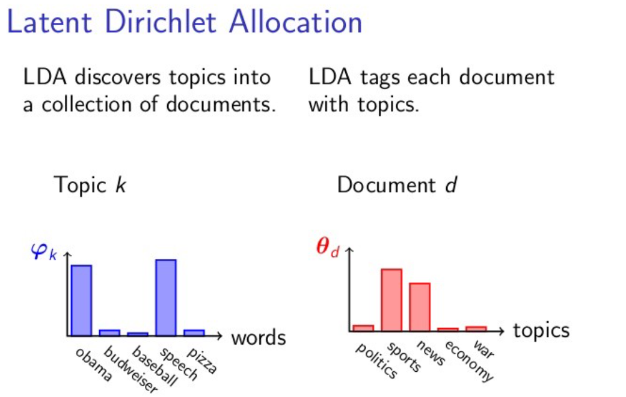
Outlook
Improvements of the Model - LDA
A generative statistical model → explain some parts of the data are similar
Figure: Principle of Latent Dirichlet Allocation (LDA)

Slide 26
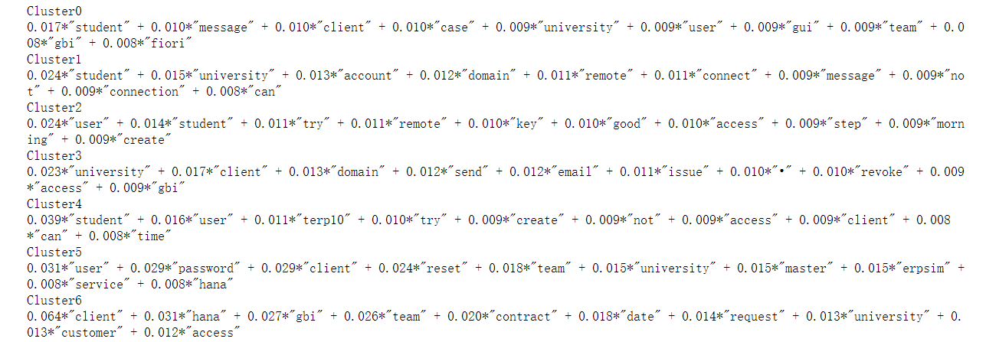
Outlook
Improvements of the Model - LDA
Problem: Not perform well compared with the LSA model
Reason: The number of our ticket samples is only 10k, which is relatively small
Solution: Collecting more user data (100k)
Figure: Clusters after LDA algorithm

Slide 27
Thank you for attention!

